Slide 2
Objectives
Knowledge:
How do we use predicates to understand documentation?
What is the difference between place-image and overlay/xy?
Skills:
Solve problems using place-image and overlay/xy.
Determine which functions are appropriate for which problems.

Slide 3
HW Problem: Count the pixels

Slide 4
Return a property
Moses question from yesterday

Slide 5
Images are like strings
data made up of other data

Slide 6
Satisfies predicate
(string? "happy")
#true

Slide 7
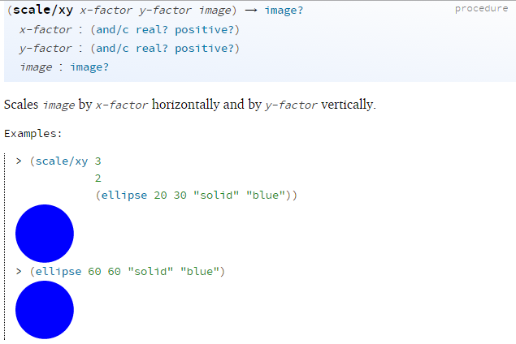

Slide 8
Documentation scavenger hunt
place-image and overlay/xy documentation

